Slide 1


Semiconductor Wafer
Yield Prediction
Leakage‑Safe • Cost‑Aware ML • Chrono Split • Calibration • SHAP
by Himanshu Saini

Slide 2
Outline
Problem Statement
Exploratory Data Analysis
Leakage-Safe ETL Pipeline
Split & Metrics
Results
Interpretability
Conclusion
@Himanshu Saini • McMaster Alum • Data Scientist

Slide 3
Problem Statement & Goal
Problem Statement: In a semiconductor fab, a small fraction of wafer runs (~6.6%) fail final quality control, yet each miss is costly; rule-based alarms either miss excursions or flood operators with false alerts. The telemetry is high-dimensional (590 sensors), partially missing, correlated, and time-ordered, so naive training leaks future information and accuracy metrics are misleading under severe class imbalance. The problem is to predict—before QC release—which runs are likely to fail, producing calibrated probabilities that enable cost-aware thresholds and a controlled alarm load.
Goal: Deliver a leakage-safe, chronologically validated ML system that outputs calibrated per-run failure probabilities and selects the cost-minimizing threshold for the fab’s chosen FN:FP ratio and alarm budget.
Motivation: Cut rework and downtime, focus engineering on high-risk runs, and manage alarm volume.
@Himanshu Saini • McMaster Alum • Data Scientist

Slide 4
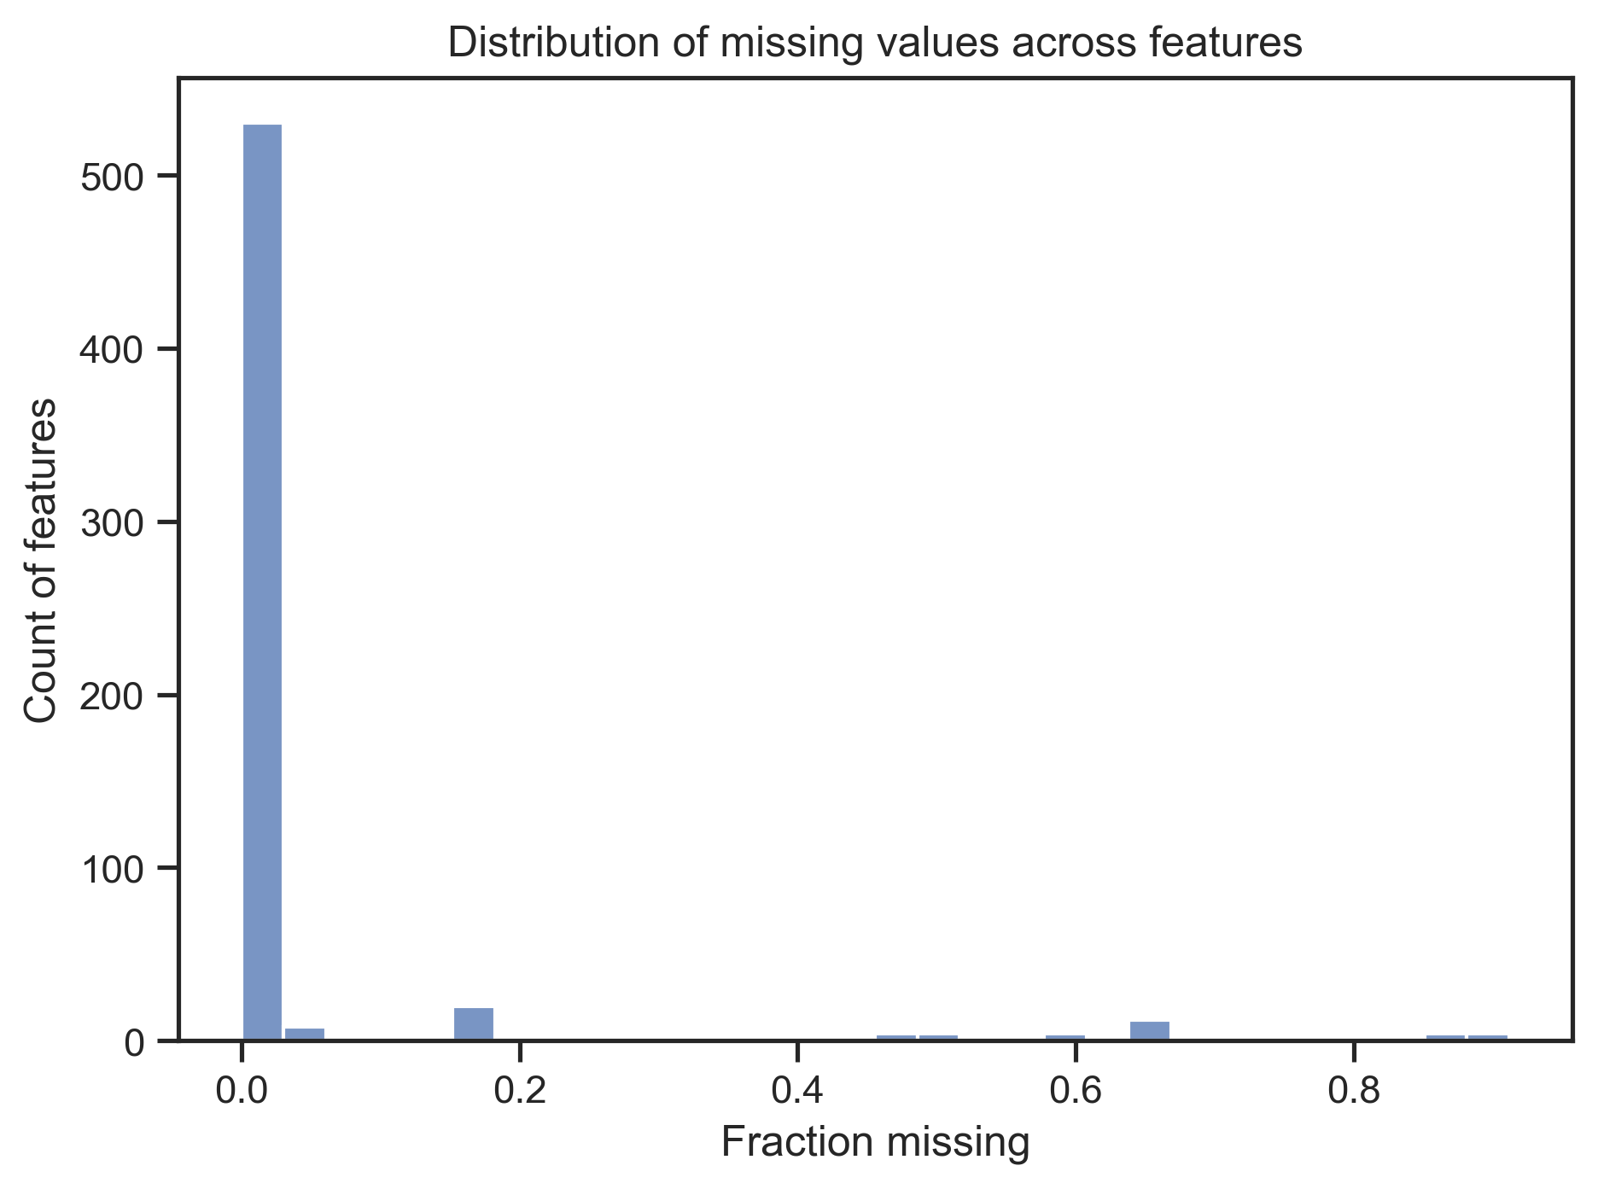
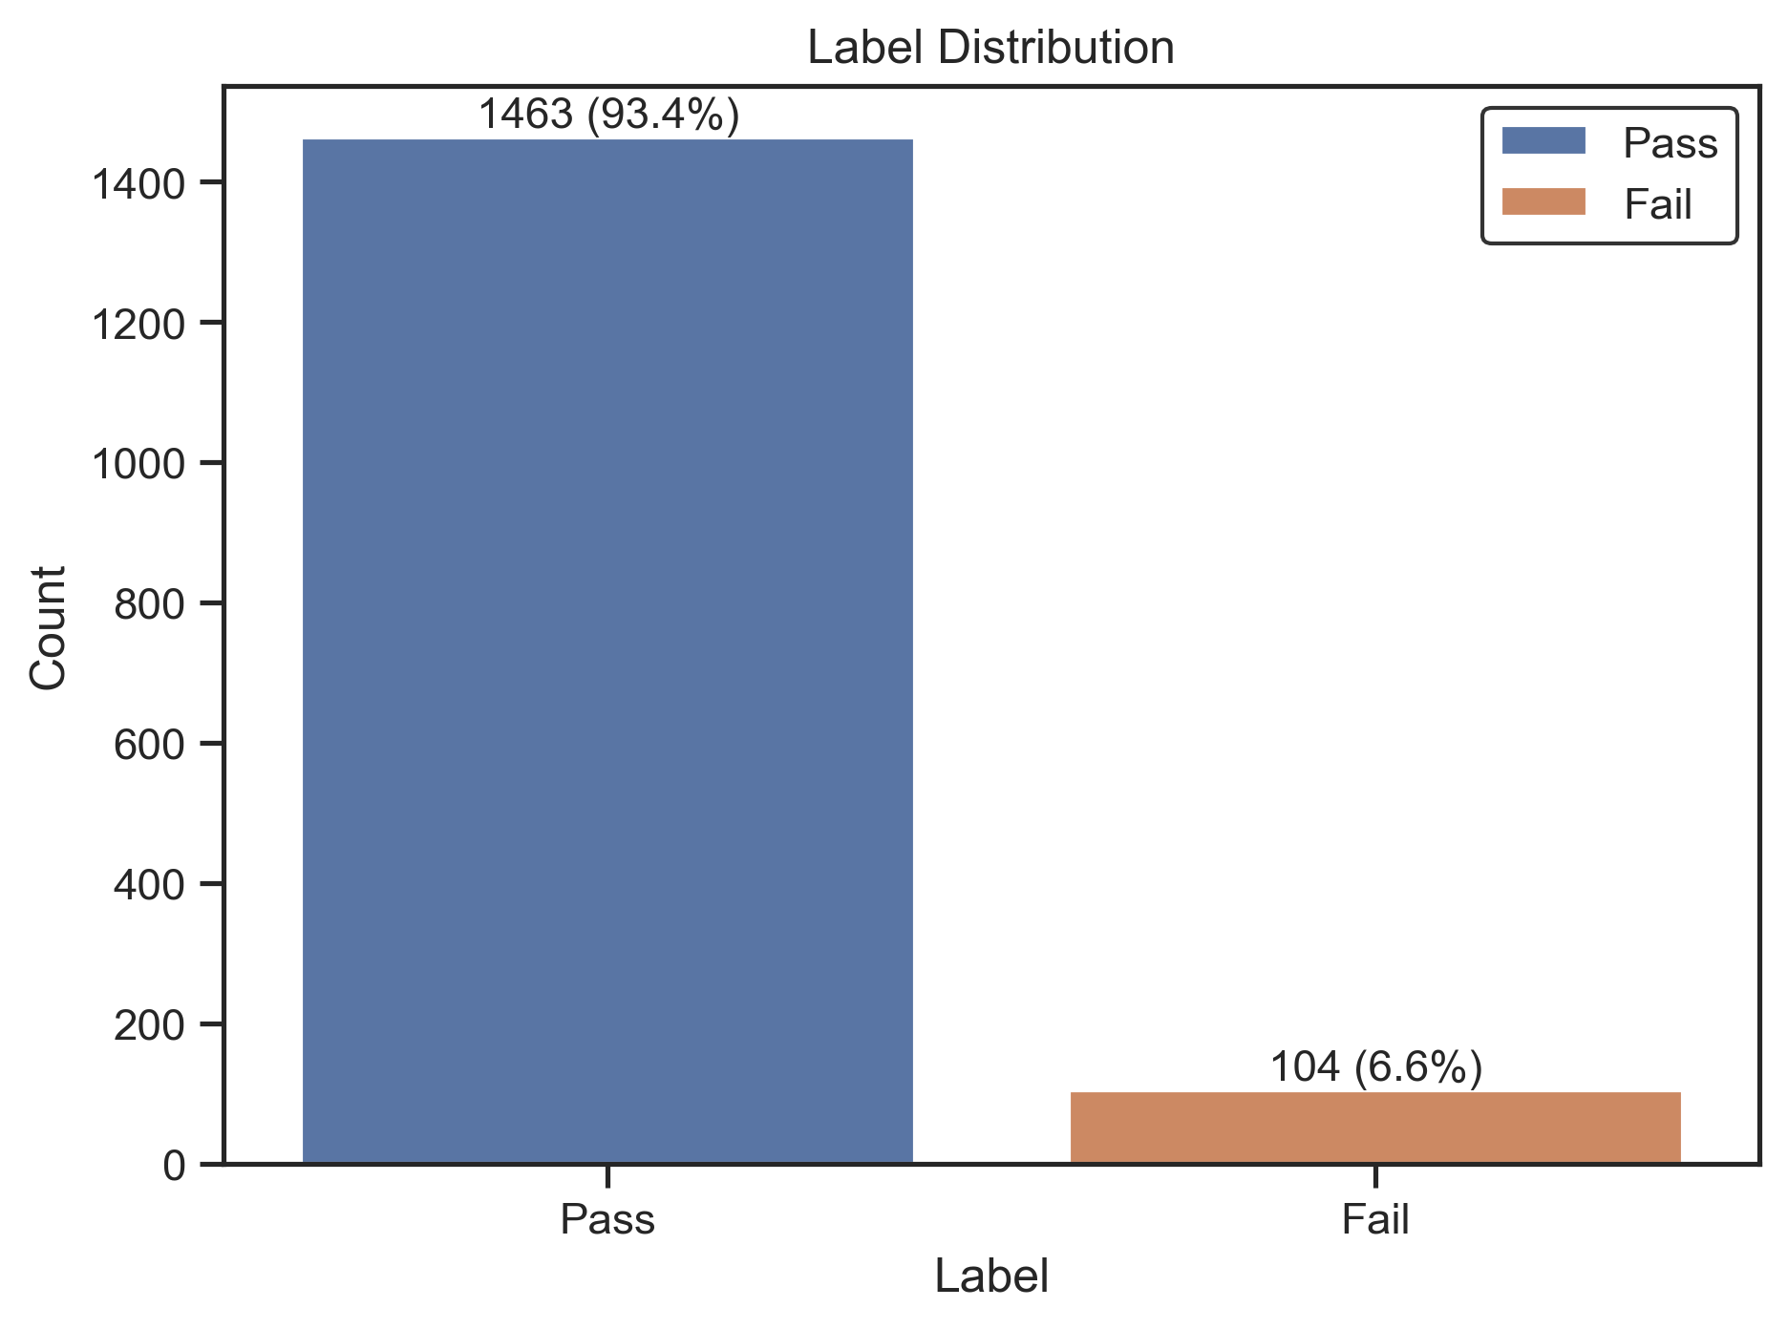
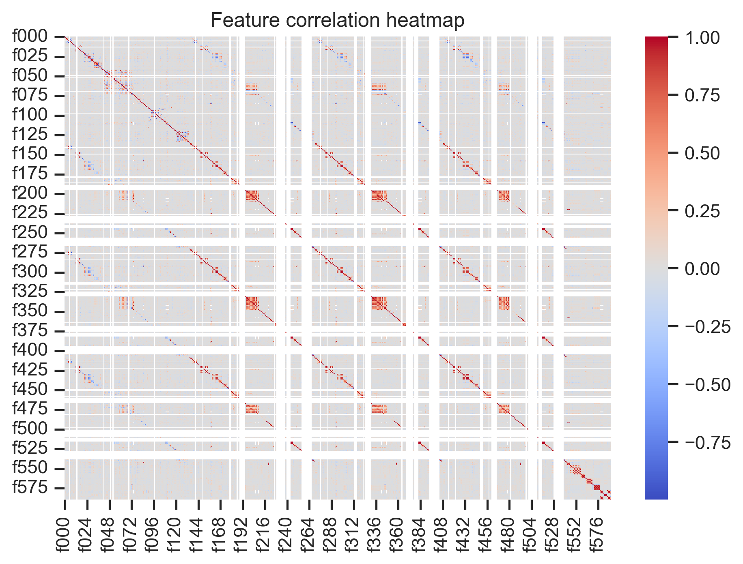
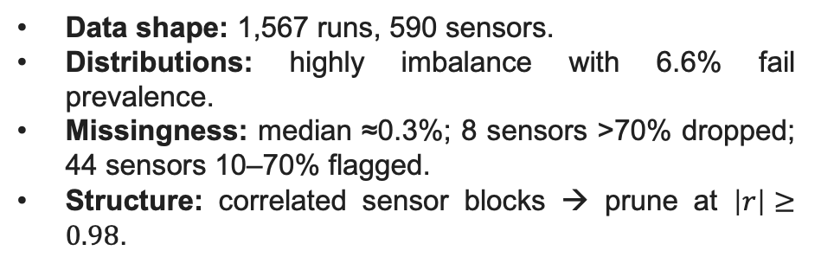
Exploratory Data Analysis (EDA)
EDA summary
Data shape: 1,567 runs, 590 sensors.
Distributions: highly imbalance with 6.6% fail prevalence.
Missingness: median ≈0.3%; 8 sensors >70% dropped; 44 sensors 10–70% flagged.
Structure: correlated sensor blocks → prune at $\left|r\right|≥0.98$.
@Himanshu Saini • McMaster Alum • Data Scientist

Slide 5
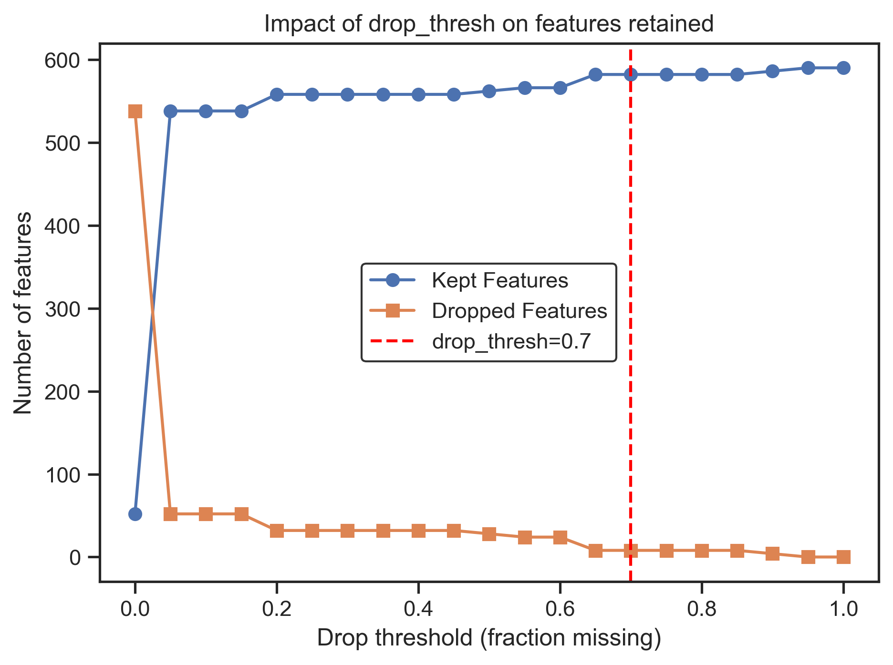
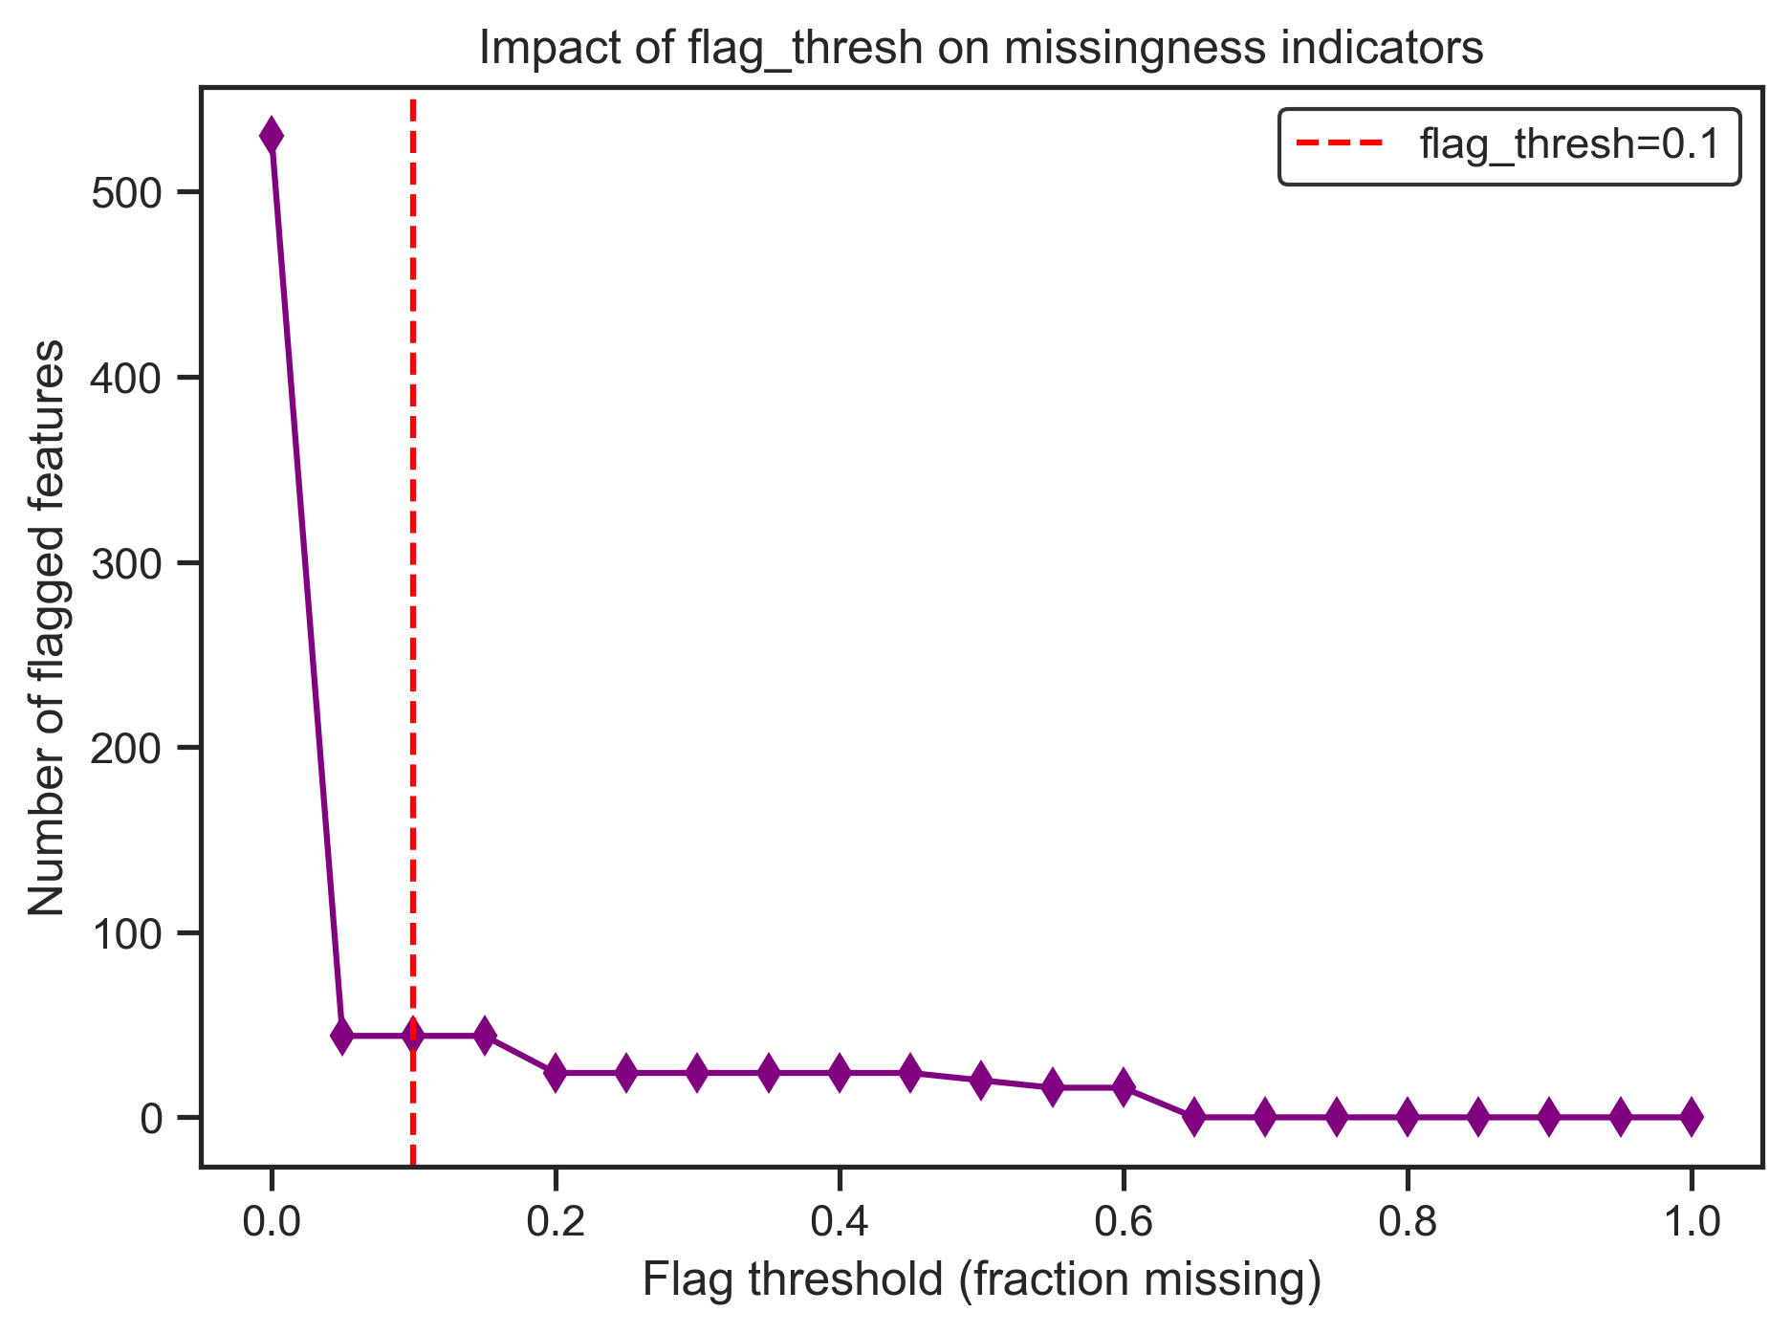
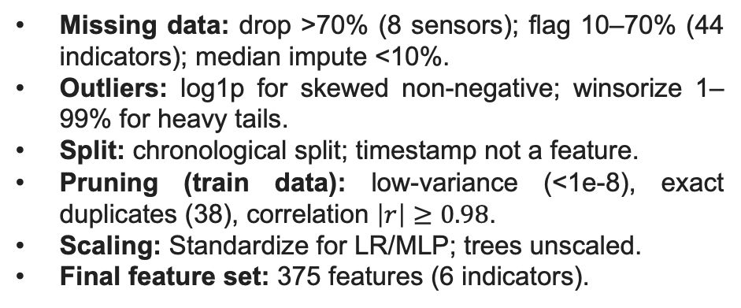
Leakage-Safe ETL Pipeline
ETL summary
Missing data: drop >70% (8 sensors); flag 10–70% (44 indicators); median impute <10%.
Outliers: log1p for skewed non-negative; winsorize 1–99% for heavy tails.
Split: chronological split; timestamp not a feature.
Pruning (train data): low-variance (<1e-8), exact duplicates (38), correlation $\left|r\right|≥0.98$.
Scaling: Standardize for LR/MLP; trees unscaled.
Final feature set: 375 features (6 indicators).
@Himanshu Saini • McMaster Alum • Data Scientist

Slide 6
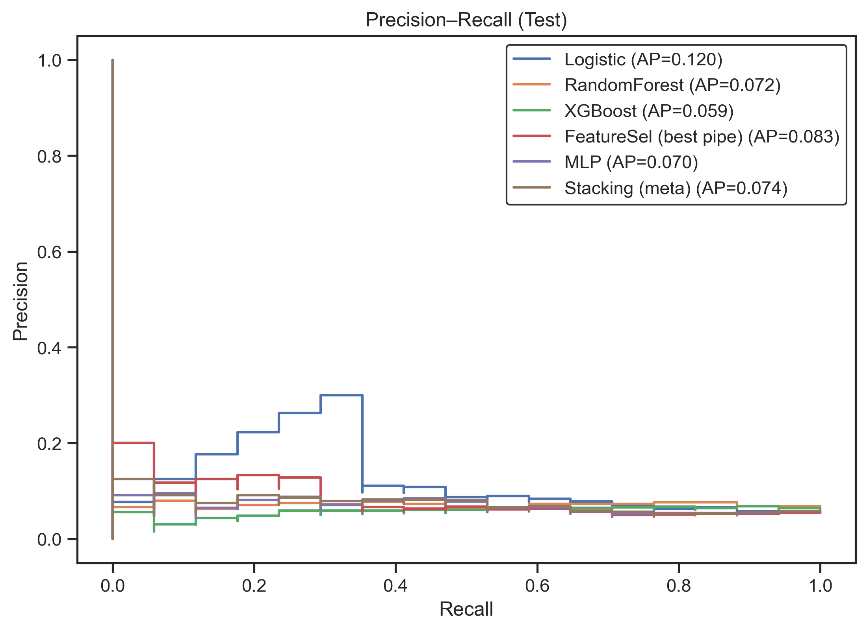
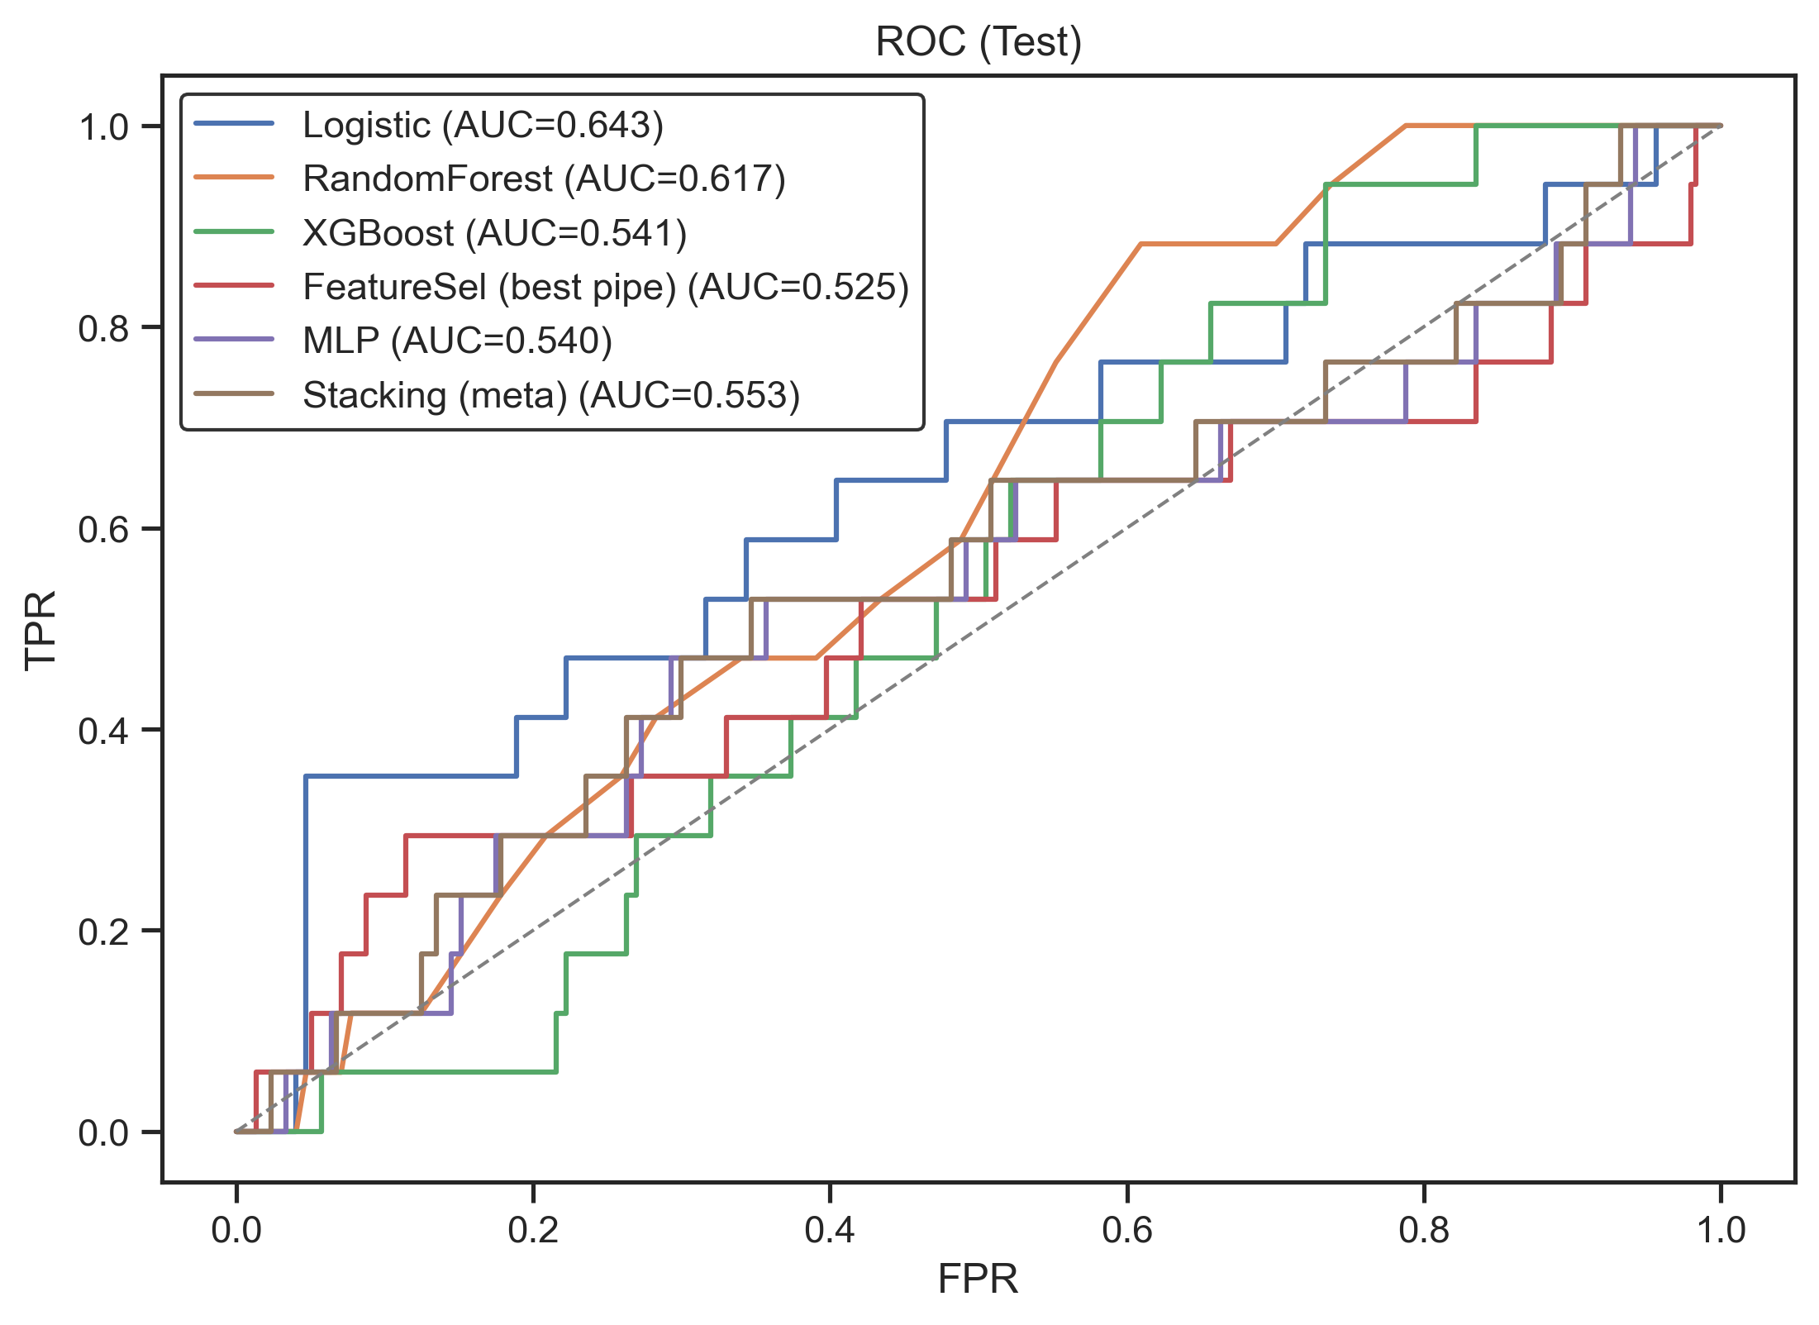
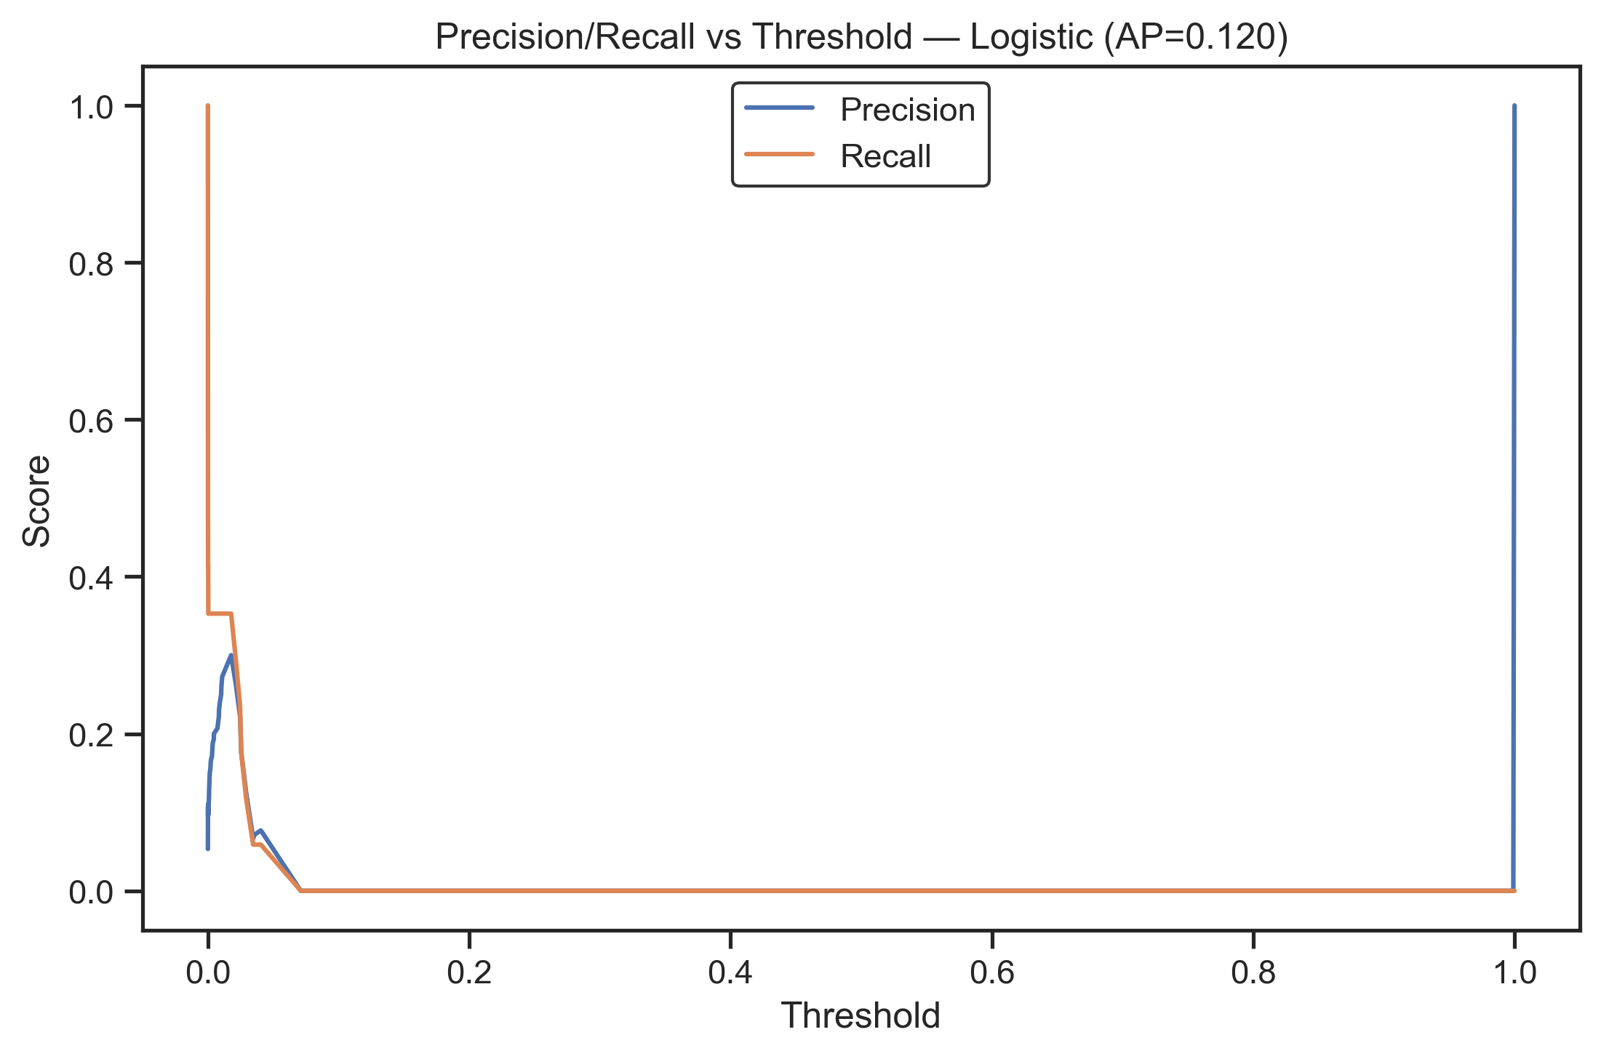
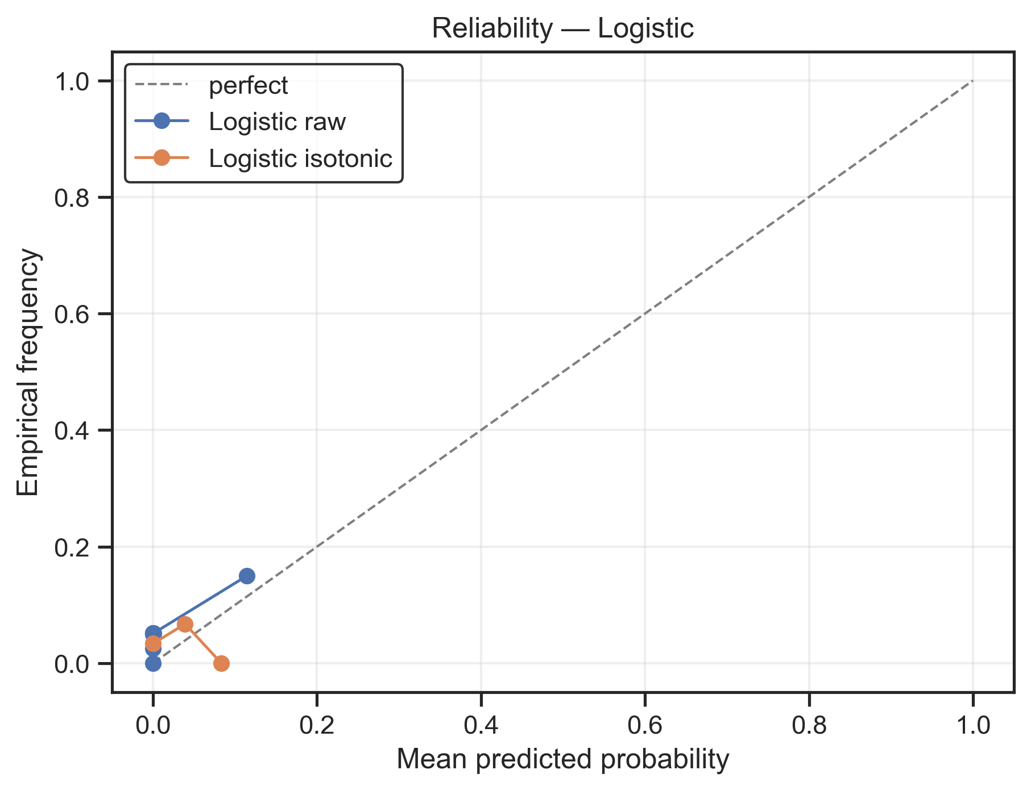
Split & Metrics
Evaluation design
Split: chronological 60/20/20 by timestamp; fit transformers on train only.
Thresholds tuned on validation; test used once for final reporting.
Primary metric: PR-AUC (rare-event focus).
Secondary: ROC-AUC, Balanced Accuracy.
Calibration on validation: isotonic and sigmoid; thresholds re-picked post-calibration.
@Himanshu Saini • McMaster Alum • Data Scientist

Slide 7
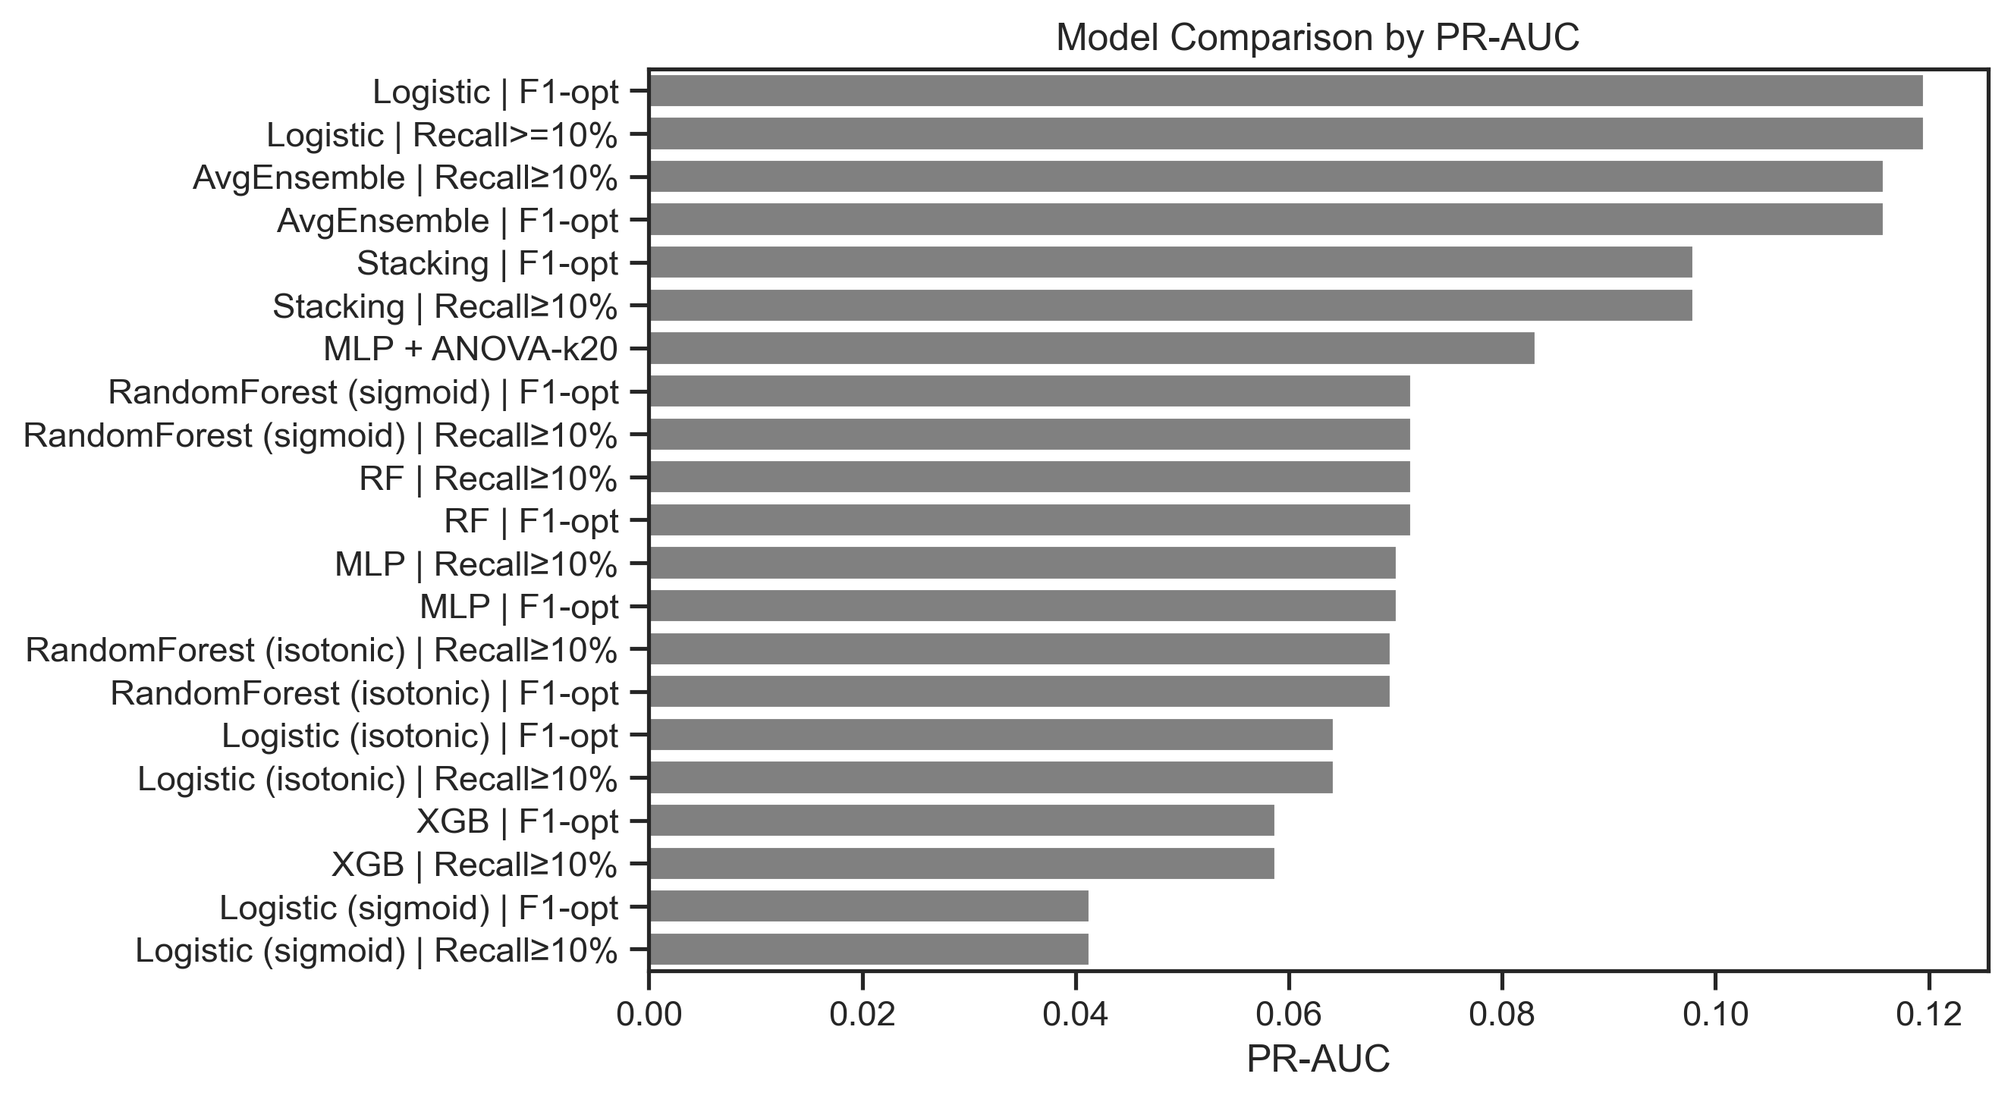
Results — PR‑AUC
Key findings
Logistic Regression PR-AUC ≈ 0.120 (test)
Simple averaging ≈ 0.116; Stacking ≈ 0.098
Random Forest ≈ 0.072; MLP ≈ 0.070; XGBoost ≈ 0.059
Absolute precision low in rare-event regimes
@Himanshu Saini • McMaster Alum • Data Scientist

Slide 8
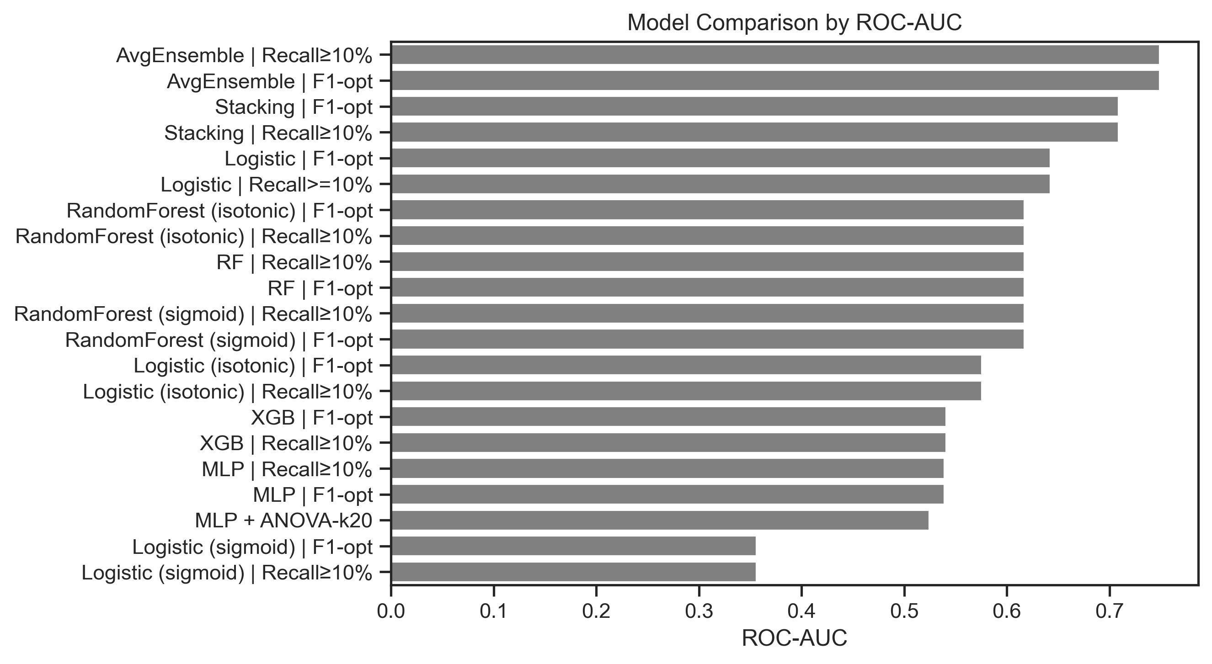
Results — ROC‑AUC
Secondary check
Avg ensemble ROC-AUC ≈ 0.749; Stacking ≈ 0.709
Logistic ≈ 0.643; Random Forest ≈ 0.617
ROC is supportive. PR-AUC stays primary under 6.6% prevalence.
@Himanshu Saini • McMaster Alum • Data Scientist

Slide 9
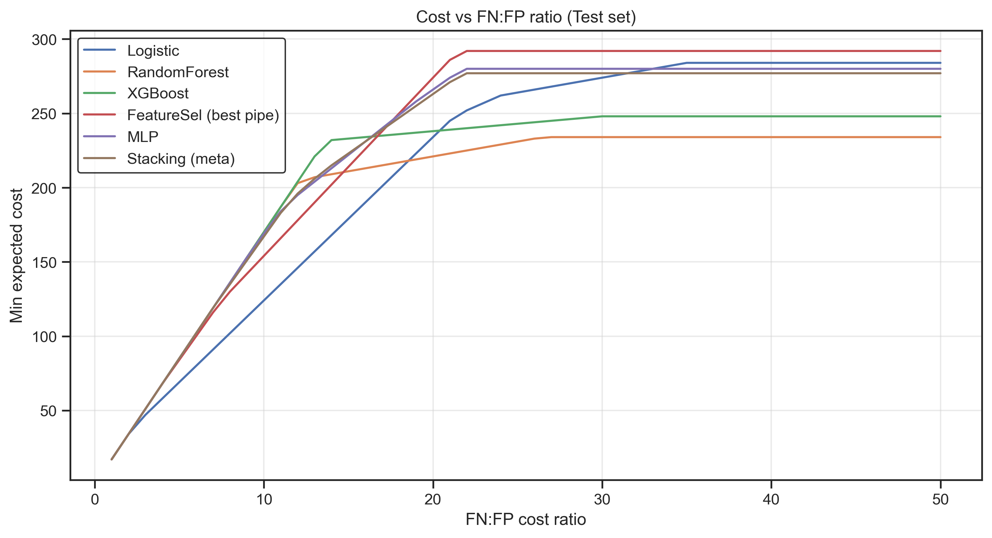
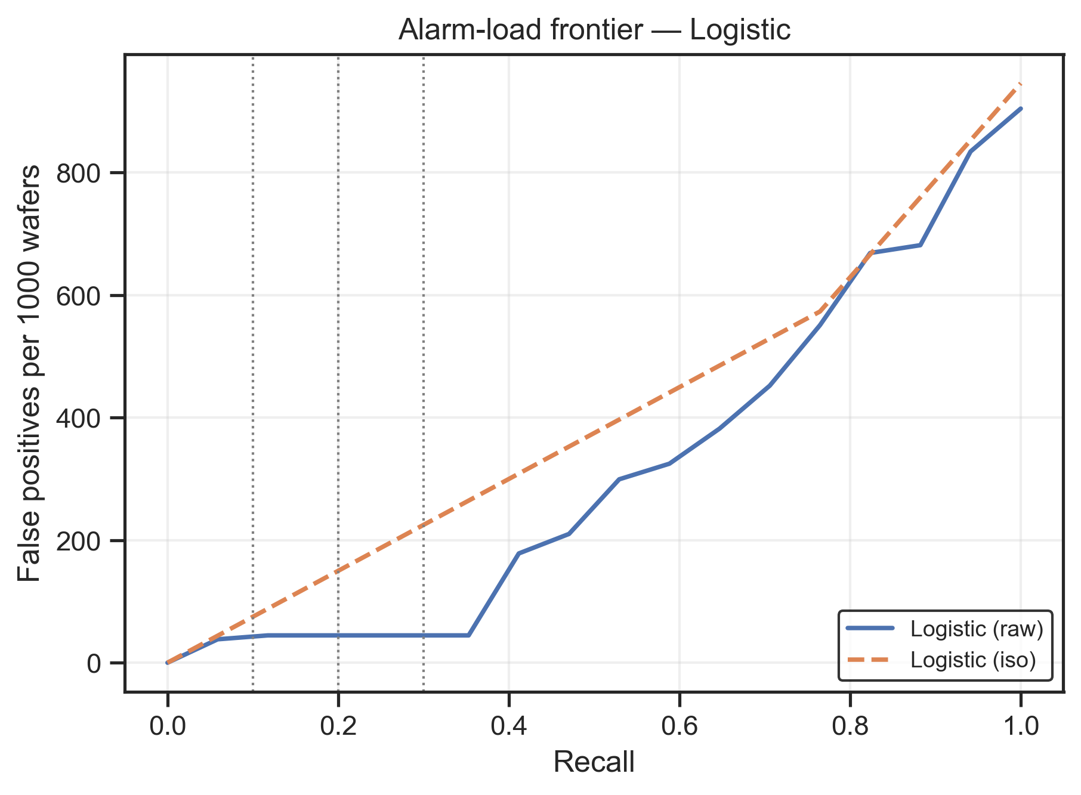
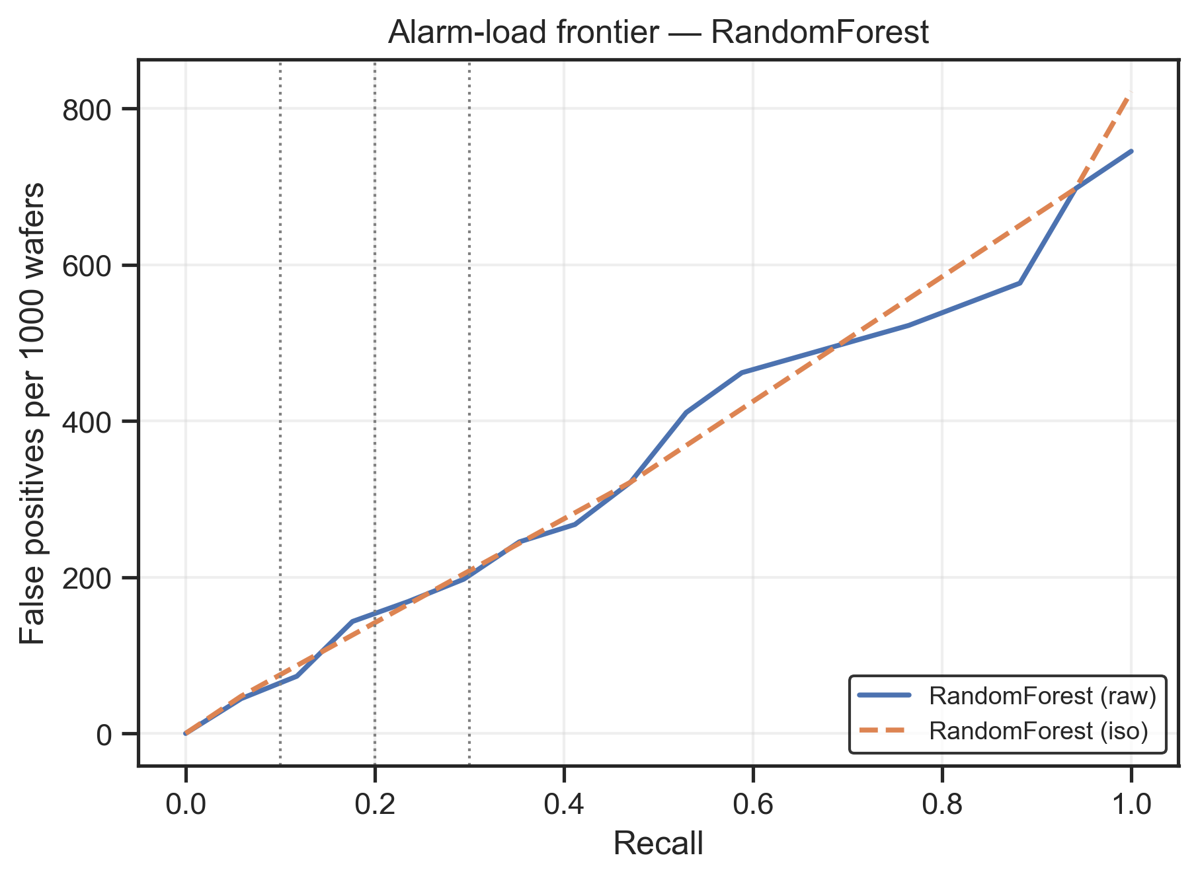
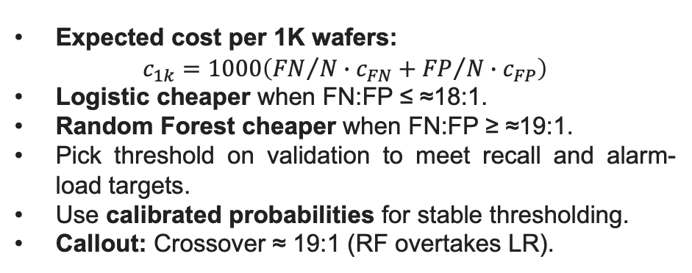
Cost‑Sensitive Operations
Decision guidance
Expected cost per 1K wafers:
$$c_{1k}=1000\left({FN}/{N∙c_{FN}}+{FP}/{N∙c_{FP}}\right)$$
Logistic cheaper when FN:FP ≤ ≈18:1.
Random Forest cheaper when FN:FP ≥ ≈19:1.
Pick threshold on validation to meet recall and alarm-load targets.
Use calibrated probabilities for stable thresholding.
Callout: Crossover ≈ 19:1 (RF overtakes LR).
@Himanshu Saini • McMaster Alum • Data Scientist

Slide 10
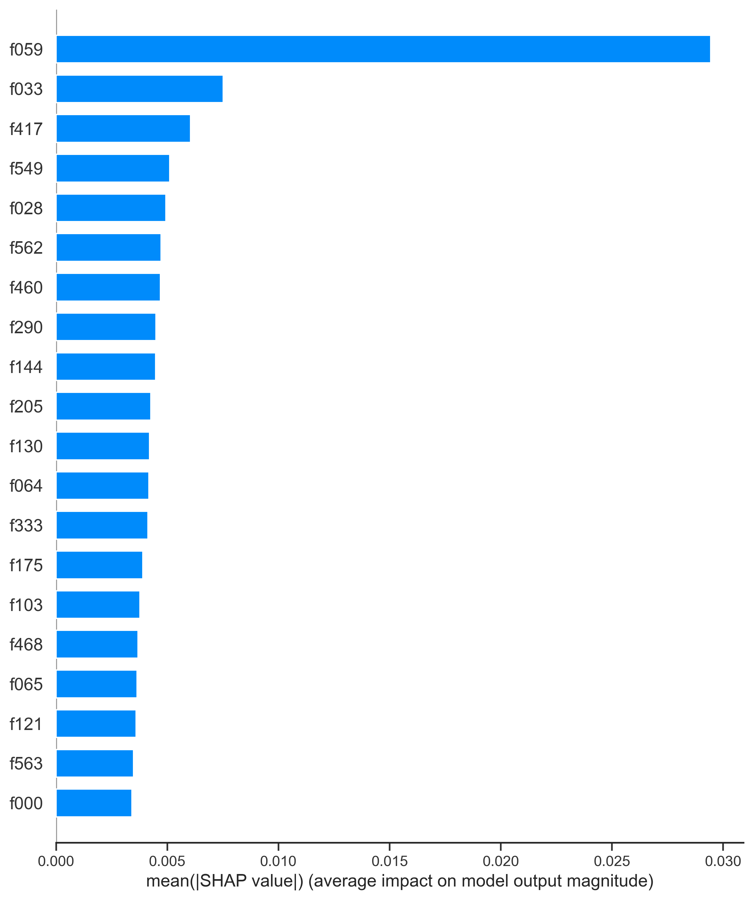
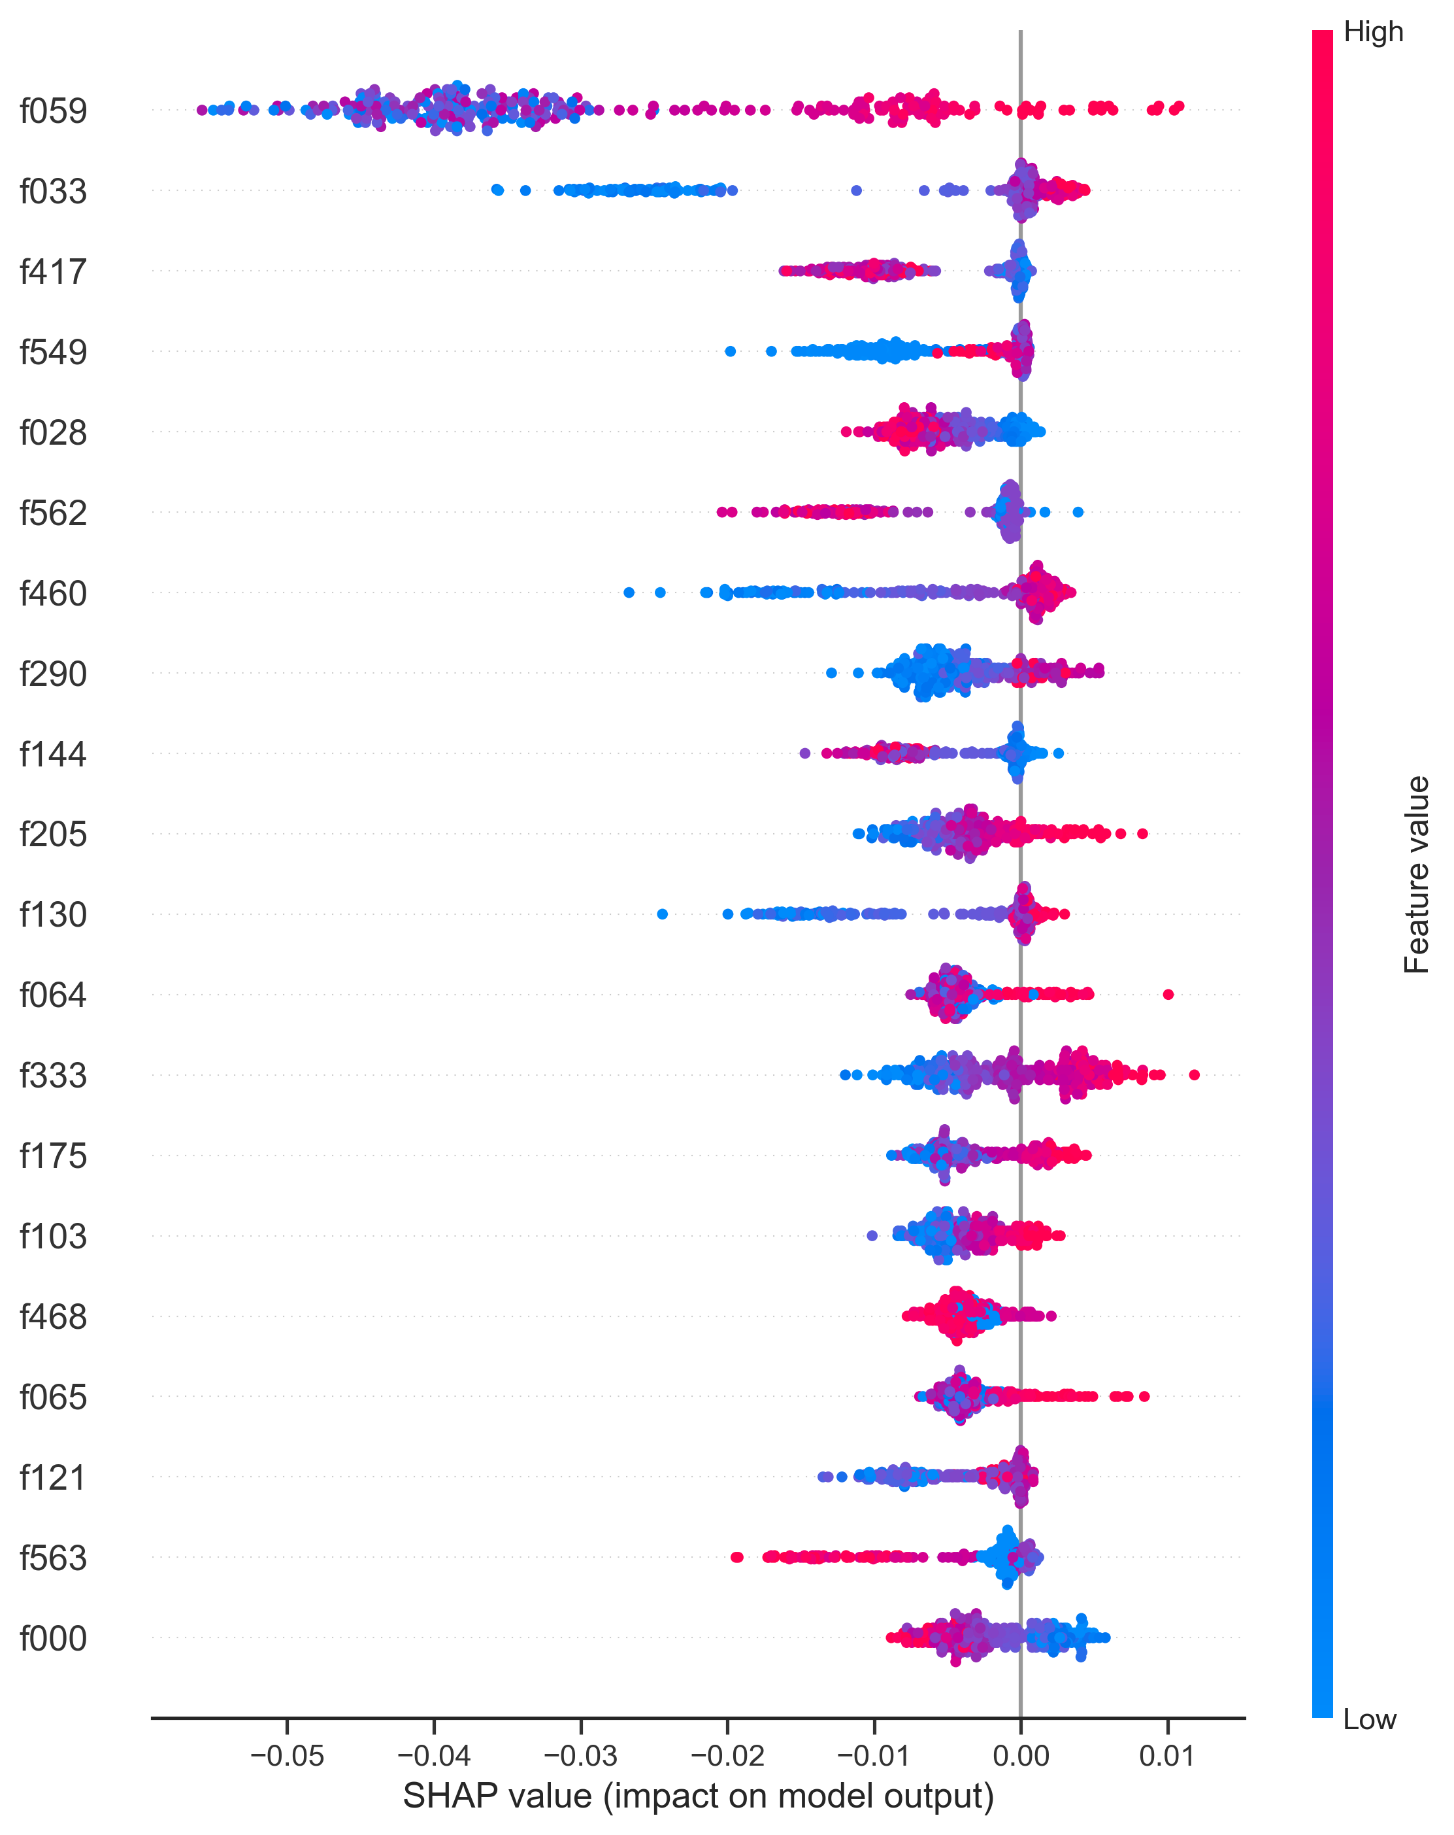
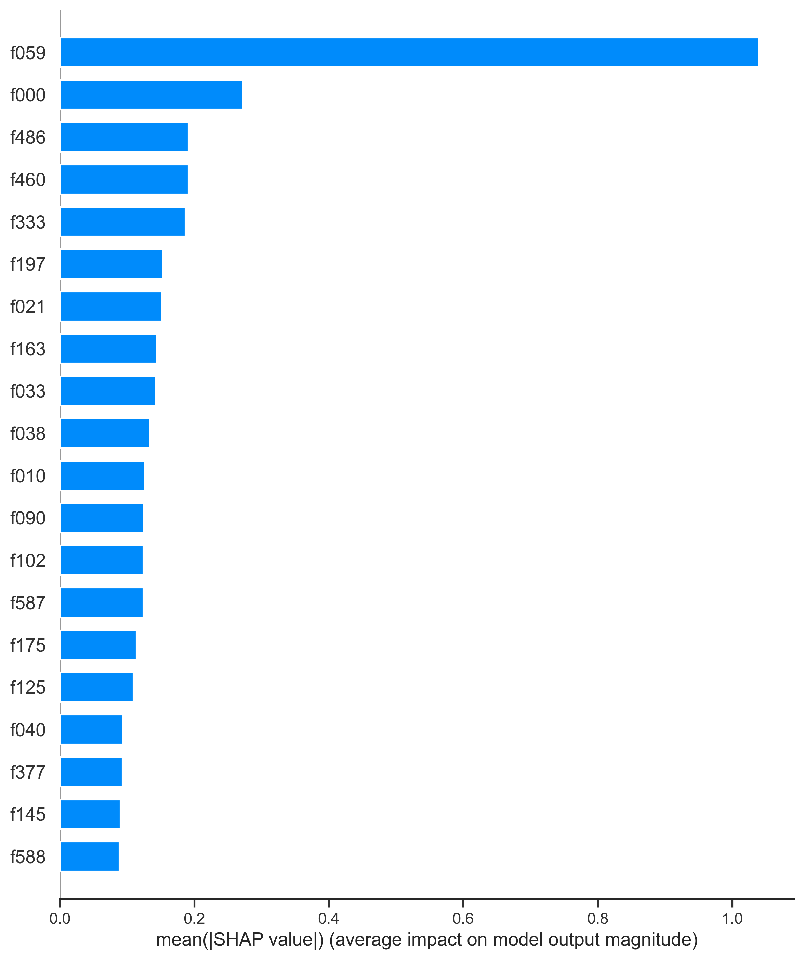
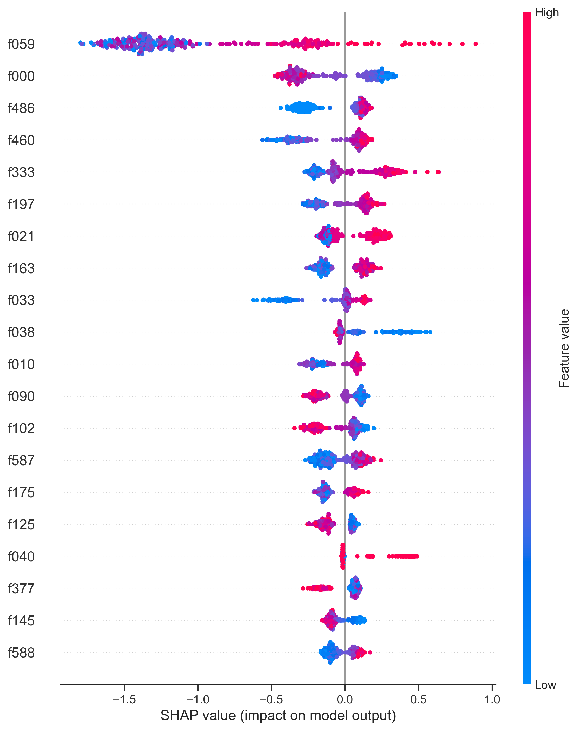
Interpretability — SHAP
Stable signals
RF
TreeSHAP on RF/XGB; consensus top sensors: f033, f059, f175, f333, f460.
High f059 pushes toward Fail; LR shows f059_missing as risk.
Combine global bars, beeswarms, and dependence for monitoring.
XGB
@Himanshu Saini • McMaster Alum • Data Scientist

Slide 11
Conclusion
Leakage-safe pipeline across EDA → ETL → chrono split.
PR-AUC as primary metric under 6.6% prevalence
Model choice depends on FN:FP; LR ≤18:1, RF ≥19:1
SHAP isolates stable sensor drivers (f033, f059, f460, …)
Calibrated probabilities enable actionable thresholds
GitHub: https://github.com/himanshusaini11/DataScience/tree/master/Project3-SECOMSemiconductorYieldPrediction
Thank you!
@Himanshu Saini • McMaster Alum • Data Scientist

